Slide 1
My best friend
SA14011131 jack xu

Slide 2
My best friend
My best friend is YY，because his Chinese name is yangyong。
He is my classmate in senior middle school

Slide 3
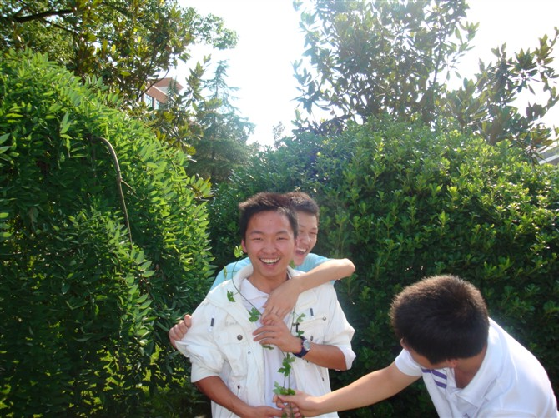
Playing games Together

Slide 4
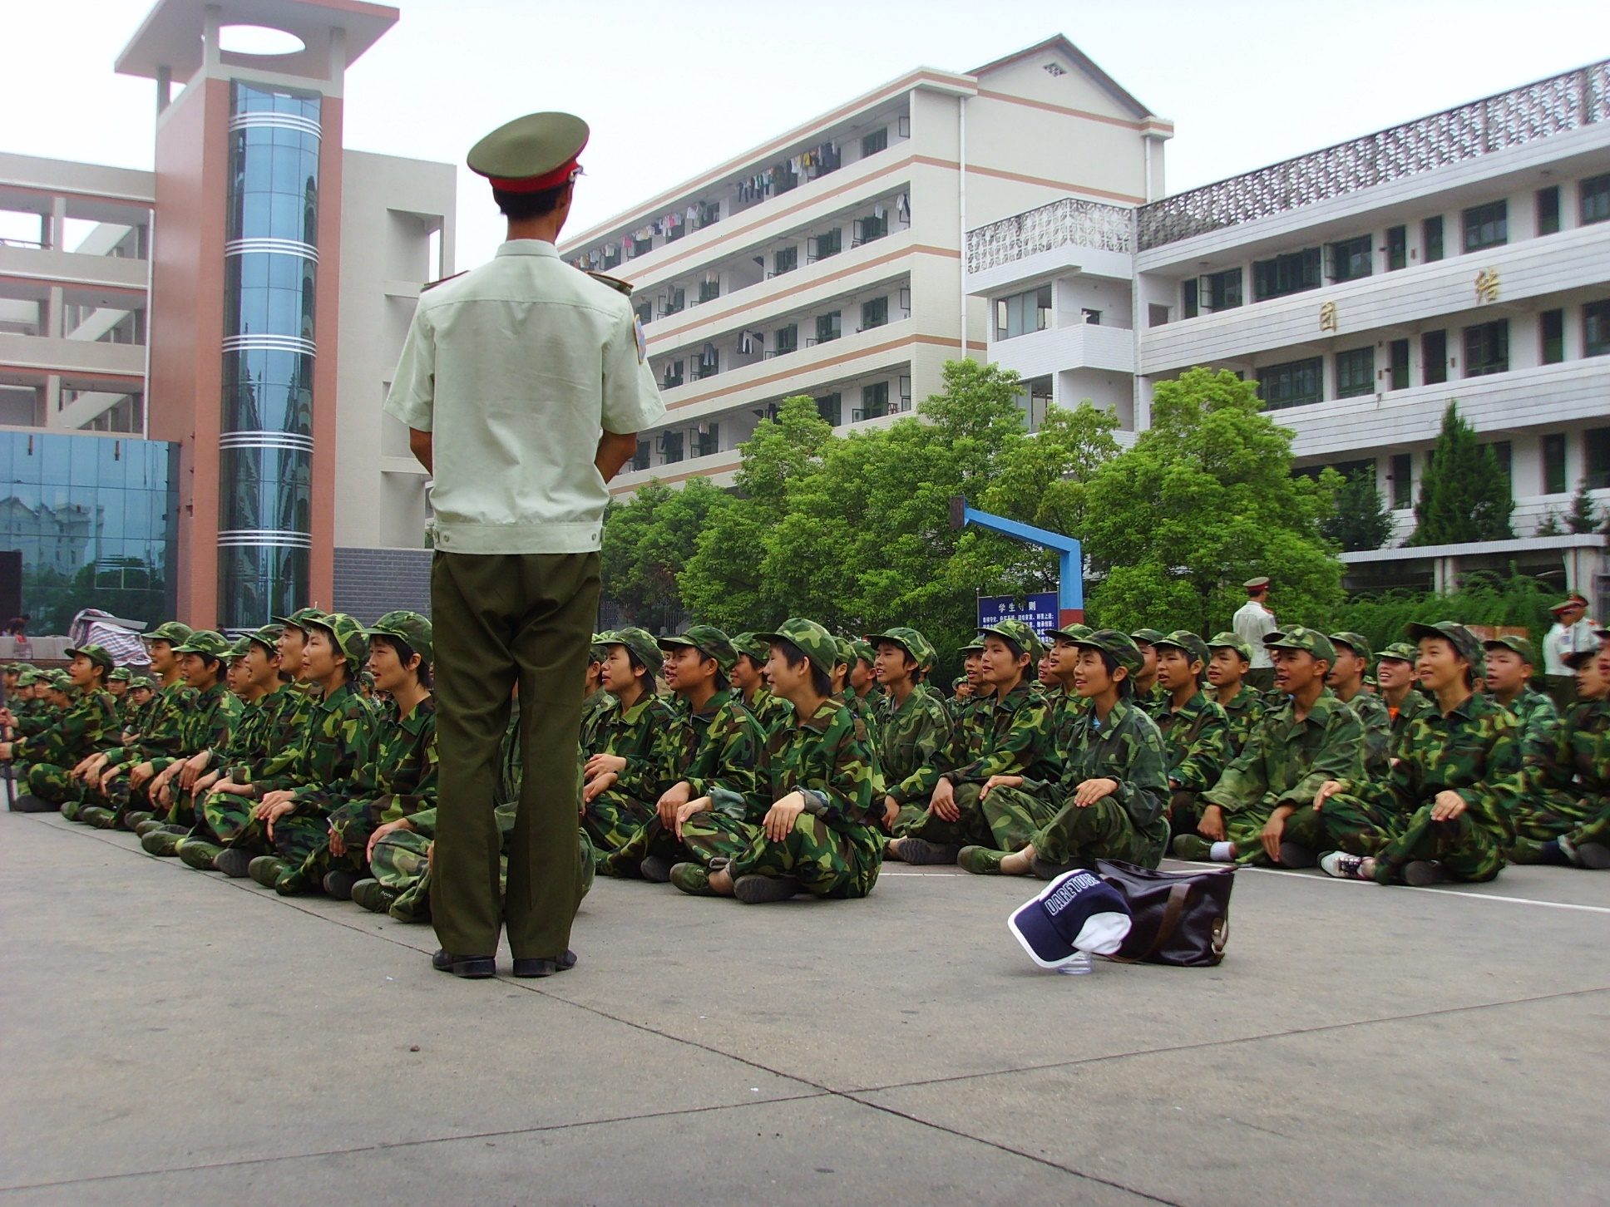
Military Training Together

Slide 5
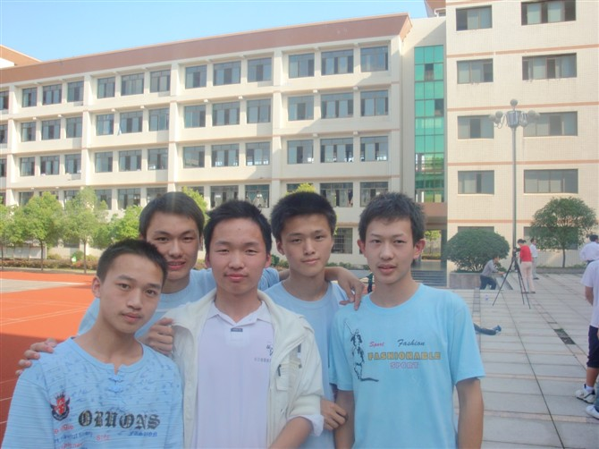
Study Together

Slide 6
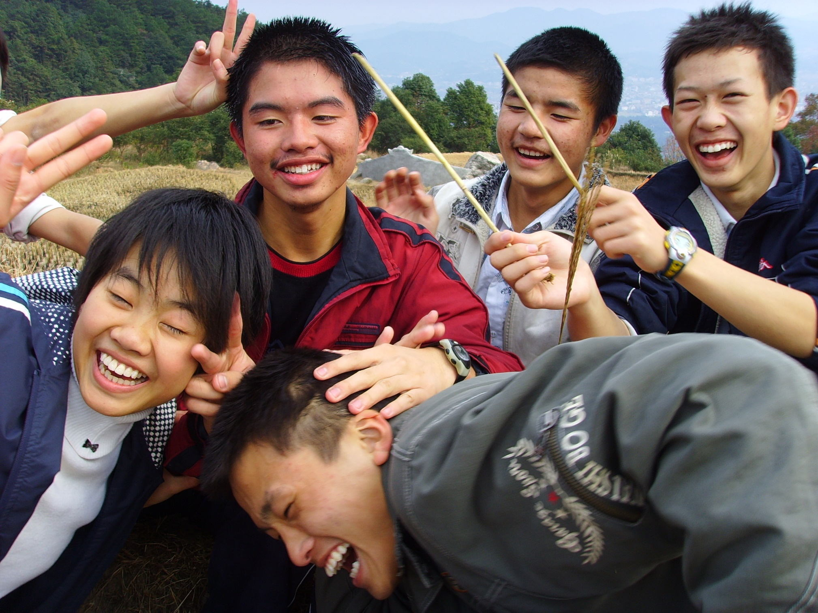
Mountain climbing and play Together

Slide 7

Help each other

Slide 8
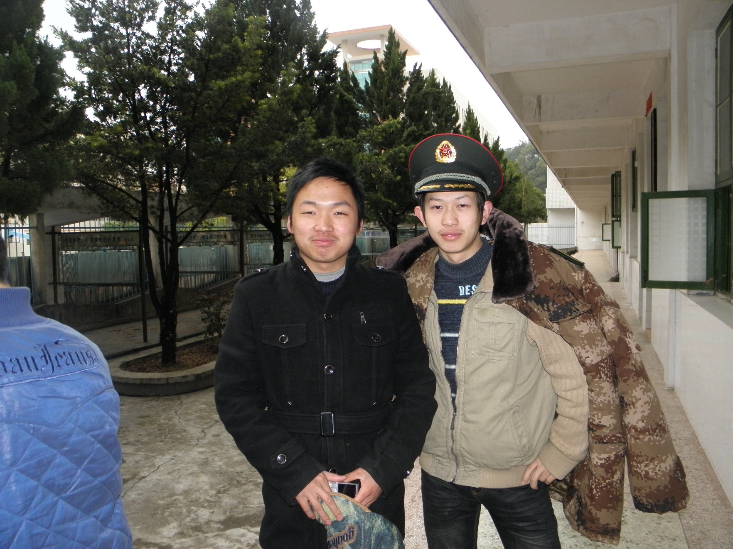
class party two years ago

Slide 9

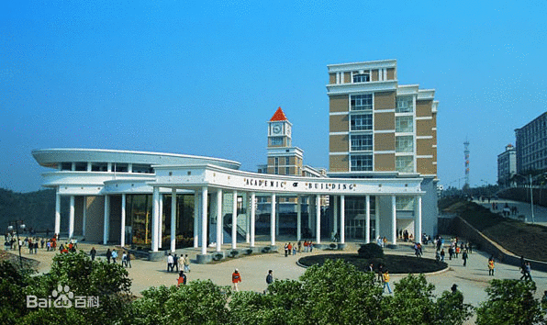
NOW
He was graduated from Hunan International Economic university in June 2014.
He wants to be a lawyer
and he is studying for
lawyer qualification
certificate now.

Slide 10
Friendship
We have known each other for seven years.
We study , play and grow together.
I am very lucky to have him as my best friend.
A brother may not be a friend, but a friend will always be a brother.

Slide 11
Thanks
SA14011131 Jack xu

